Slide 1
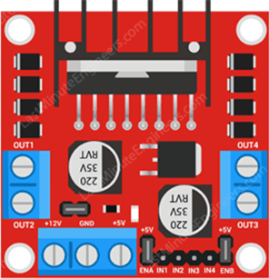
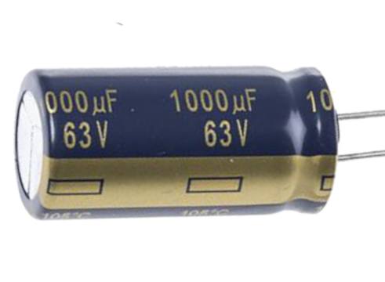
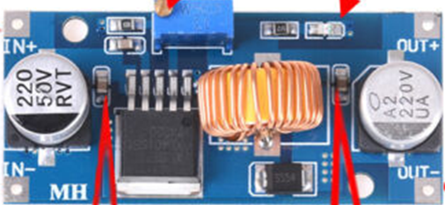
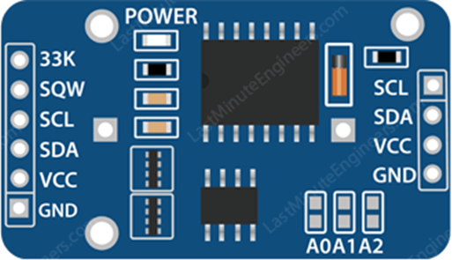
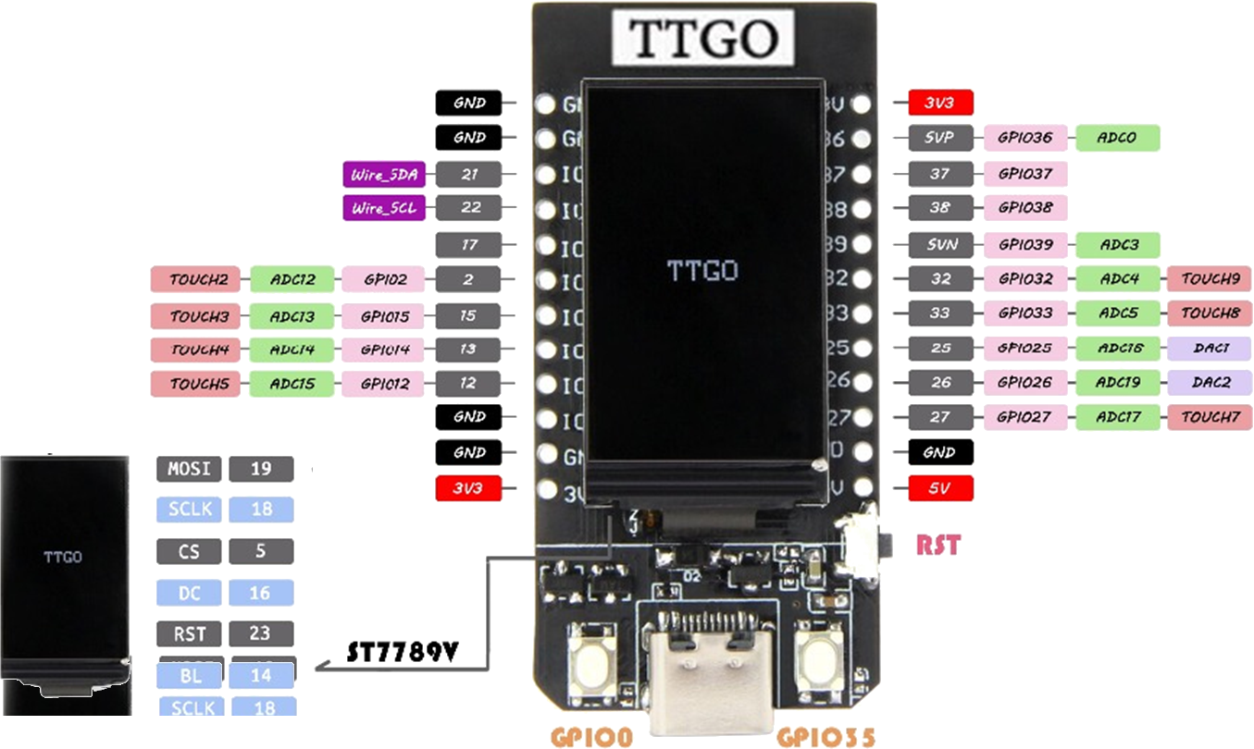
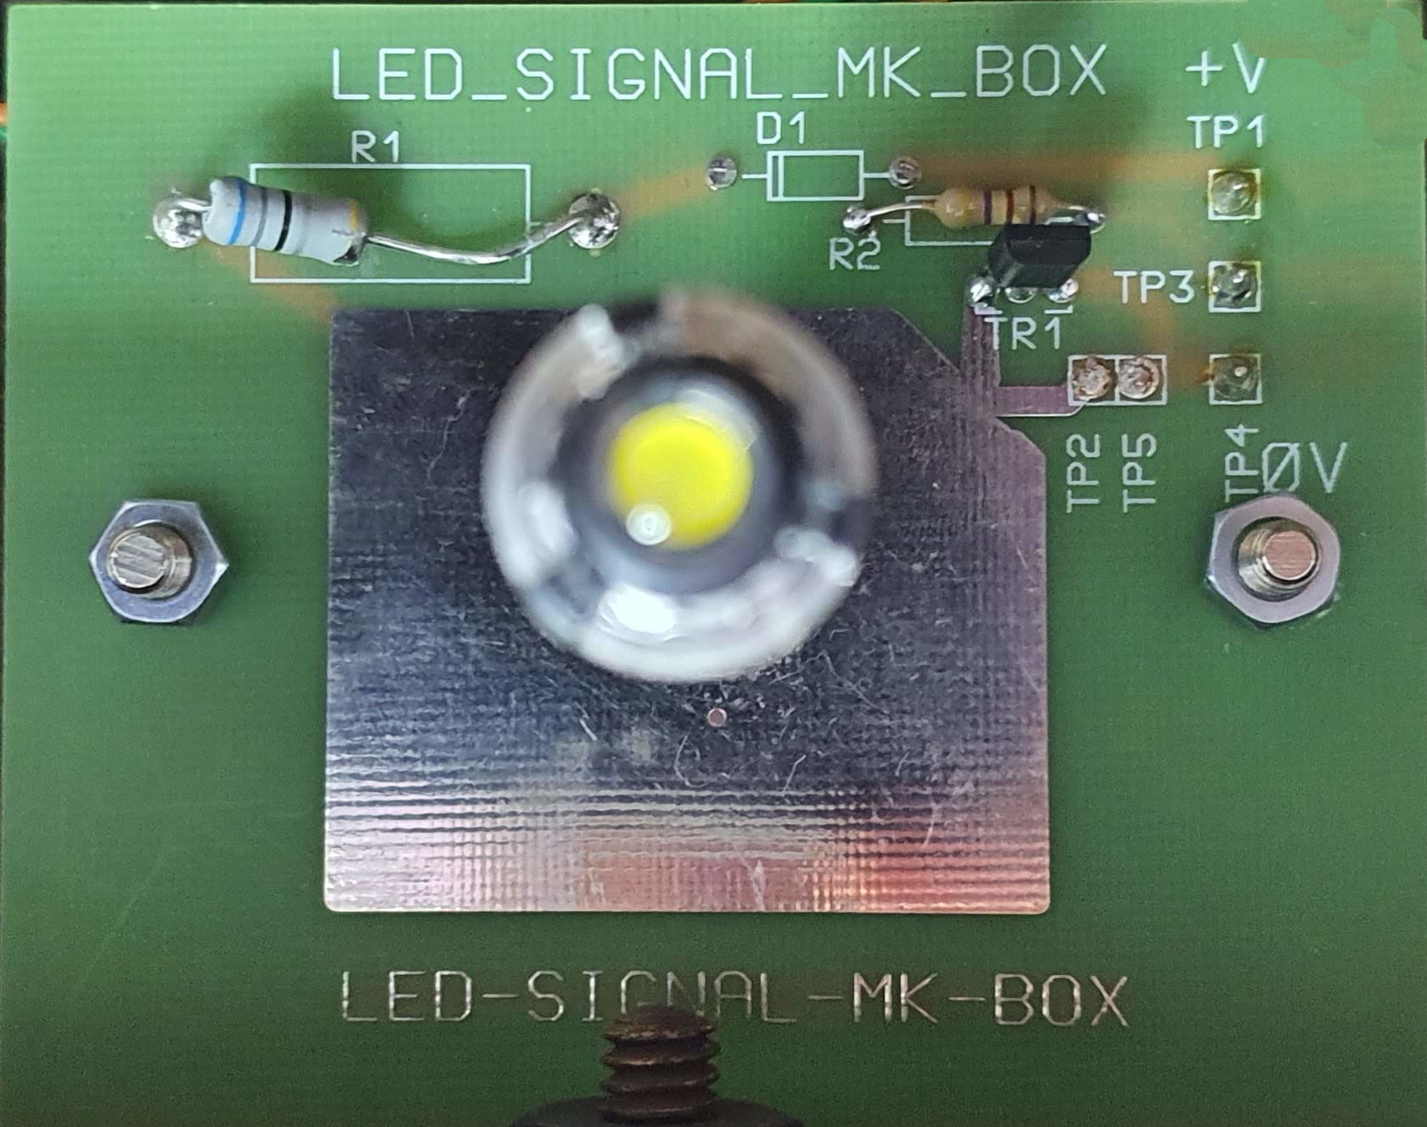
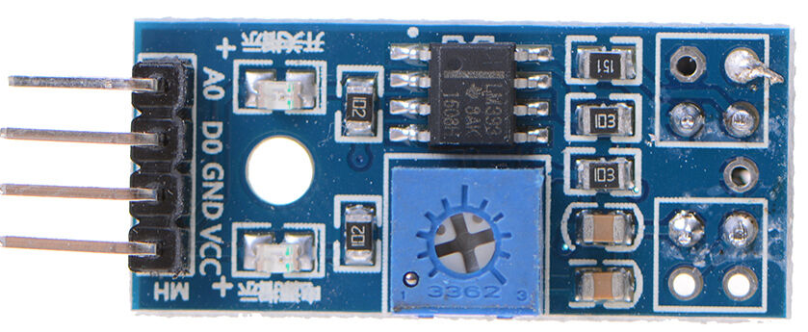
36V in
M3 by 2
Motor
24-pin SIL only
M2.5 by 3
Rear access needed (battery)
Could mount on pins
M3 by 4

Slide 2
Second hand
phase
0
1
2
3
0
0
1
2
Pulse count
1
2
3
4
5
6
Note – edges are quite noisy – typically 4+ edges per step

